Slide 1
Leveraging Advice to Build a Brighter Future
Presenter Name, Presenter Title
1
Notes:
READ SLIDE

Slide 2
Why does advice matter more now than ever?
2
LEVERAGING ADVICE TO BUILD A BRIGHTER FUTURE
FOR FINANCIAL PROFESSIONAL USE ONLY.
Notes:
READ SLIDE

Slide 3
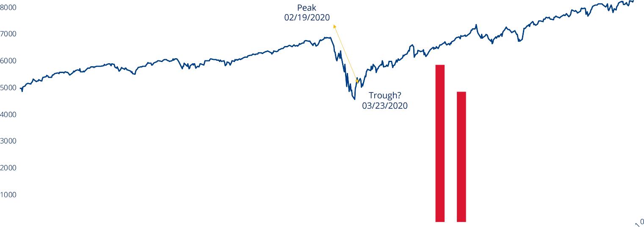
Uncertainty surrounds the impact of the pandemic and election cycle on the economy
S&P 500® Total Return Index and unemployment rate
12/2018
06/2019
/2019
06/2020
12/2020
03/2021
12
3
LEVERAGING ADVICE TO BUILD A BRIGHTER FUTURE Sources: Investment Company Institute, S&P 500, Bloomberg, Bureau of Labor Statistics.
FOR FINANCIAL PROFESSIONAL USE ONLY.
Notes:
The pandemic caused a lot of uncertainty when it came to the market and jobs.

Slide 4
Confidence in economy has taken a big hit
How confident are/were you in the U.S. economy?
(% Top 2 box very/somewhat confident)
69%
Confidence in the U.S. economy by demographic:
Today: In 6 months:
58%
52%
47%
47%
47%
42
%
37%
35%
32%
April 2020
June 2020
December 2020
June 2021
Boomers
Women
Black respondents
Source: Empower Institute and Personal Capital, “Back to (Financial) Basics, January 2021.
4
Notes:
As a result, confidence took a big hit.

Slide 5
Retirement savings is a source of last resort
First step to accessing money Last resort for accessing money
Reduce spending
36%
Take from retirement savings account
29%
Dip into savings or emergency fund
20%
Stop contributing to retirement savings
27%
Borrow money from a family member or friend
26%
Max out credit cards
26%
Source: Empower Institute, Retirement as a Last Resort, August 2020.
5
Notes:
During this time, many people had to access money. So we wanted to find out, if people needed money, where did they plan to get it. We found that tapping retirement savings was a last resort.

Slide 6
Workplace retirement plan distributions were mostly used for basic needs
36%
35%
31%
FOOD
AND RENT
PAID DOWN
DEBT
PUT INTO
SAVINGS
Source: Empower Retirement in conjunction with The Harris Poll, Retirement Savings & Stimulus Spending, March 2021.
Notes:
READ SLIDE

Slide 7
How can retirement investors move forward financially?
Notes:
READ SLIDE

Slide 8
Top goals of 2021: Spend less, save more and seek professional advice
Which of the following are your New Year’s resolutions when it comes to your finances?
I will spend less on non-essential items
41%
I will save more of each paycheck I receive in 2021
38%
I will spend more of my time in 2021 planning my finances
41%
I will learn more about different financial strategies
25%
I will stop being afraid of managing my finances
17%
Source: Empower Institute and Personal Capital, “Back to (Financial) Basics, January 2021.
Notes:
We saw in 2020, retirement investors lost confidence in the market while remaining steadfast in the retirement savings. As we move into a post-pandemic world, retirement investors plan to focus on spending less and savings more and…

Slide 9
People want advice, they want it now and they want their employer to help.
90%
WANT A PERSONALIZED FINANCIAL PLAN THAT ADJUSTS TO MEET THEIR NEEDS¹
43%
OF GOVERNMENT EMPLOYEES BELIEVE THEIR EMPLOYERS SHOULD PROVIDE FINANCIAL WELLNESS RESOURCES²
SAY THEY WILL SEEK ADVICE IN 2021¹
1 Post-2020 employer piece: “Retirement Plans in a Post-COVID World,” Empower Institute, 2020.
2 “Staying strong: How government retirement plans are fighting COVID fatigue,” Empower Institute, 2020.
Notes:
READ SLIDE

Slide 10
Advice offered through an employer is especially important for certain population segments
More than half of respondents overall say they will not be taken seriously as a client by a financial services company
All respondents
Hispanic men
Asian men
First-gen Americans
Multicultural households
Source: Empower Institute, State of Financial Inclusion, January 2021.
Notes:
This is especially true underrepresented groups of employees. But they often times do not feel like they will be taken seriously as a client.

Slide 11
Instead, some segments are turning to friends, family and colleagues for advice about retirement
Who, if anyone, do you rely on for financial advice about saving for retirement?
44% My family
69% Asian female
68% Multilingual
67% Second-generation American
38% My financial advisor
46% White male
36% Information I find myself online
48% Interracial couple
47% Multilingual
24% Through my employer
48% Second-generation American
40% Interracial couple
25% My friends
39% Second-generation American
36% Asian female
36% First-generation American
36% Interracial couple
34% Multilingual
15% My colleagues at work
30% Multilingual
28% First-generation American
28% Hispanic male
28% Hispanic female
23% Asian female
23% Second-generation American
23% Interracial couple
Source: Empower Institute, State of Financial Inclusion, January 2021.
Notes:
This may cause they to turn to friends, family, and colleagues for advice.

Slide 12
Difficulty with financial tasks
Most difficult financial tasks (percentage that agree each task is somewhat or very difficult)
All respondents
57%
42%
Retire when I want
Understand terminology financial firms use
White males 48%
31%
Find unbiased financial advice
49%
42%
42%
Save for emergencies
32%
46%
39%
Save for retirement
Create and stick to a budget
37%
31%
46%
33%
Save for the long term
Understand emails from my retirement plan provider
36%
22%
46%
Seek financial advice when needed
32%
Pay off debt
37%
26%
Source: Empower Institute, State of Financial Inclusion, January 2021.
Notes:
All of this adds up to difficulty with financial tasks.

Slide 13
How can advice help?
Notes:
READ SLIDE

Slide 14
Advice can help retirement investors stay on track
2x
9x
MORE LIKELY TO USE TAX-OPTIMIZED SAVINGS STRATEGIES¹
MORE LIKELY TO MAINTAIN THEIR LONG-TERM STRATEGY DURING PERIODS OF VOLATILITY²
1 As of June 1, 2020. Empower recordkeeping data. Advisory Services participants utilized after-tax (Roth) savings strategies twice as often as those who didn’t use Advisory Services. 2 As of March 27, 2020. Empower recordkeeping data.
Notes:
READ SLIDE

Slide 15
Advice in a workplace plan can help retirement investors be more prepared for retirement
Benefits of having an advisor connected to a workplace plan
Use advisor (any type) connected to workplace plan
91%
Use advisor not connected to workplace plan
84%
Do not use advisor
71%
Source: Empower Institute, Scoring the Progress of Retirement Savers, September 2020.
Notes:
READ SLIDE

Slide 16
A comprehensive advice model can assist your advisor in reaching more people
THE RIGHT FIDUCIARY ADVICE WHEN IT WORKS FOR EACH EMPLOYEE
COMPREHENSIVE PERSONALIZED RETIREMENT STRATEGIES FOR EMPLOYEES
Notes:
READ SLIDE

Slide 17
Using advice to help retain assets
2020 Distribution
RSG_w_MA: RSG_w/o_MA:
100%
₈₀%
76%
67%
₆₀%
₄₀%
29%
₂₀%
14%
10%
₅%
₀%
Cash out
Roll out
Stay in plan
Source: Empower Platform Intelligence, as of December 31, 2020.
Notes:
READ SLIDE

Slide 18
What kind of advice can help?
Notes:
READ SLIDE

Slide 19
Our definition of advice
Advice on topics like:
Tax-efficient savings strategies and savings rate recommendations
Personalized investment allocations
Distributions, with a focus on staying in the plan
Financial wellness (budgeting, debt management, etc.)
Retirement income planning
ad·vice
Guidance in the best interest of the employee
Recommendations free of conflict
Notes:
READ SLIDE

Slide 20
Investors crave advice that is personalized, unbiased and simple to understand
Wish someone would explain retirement savings to them in a simple way
Think it’s important that they talk with someone who tries to understand their needs
Want an advisor who is easily accessible by phone and email
Want to hear financial advice from someone who looks like them
Source: Empower Institute, State of Financial Inclusion, January 2021.
Notes:
READ SLIDE

Slide 21
Consider a fiduciary advice model that works for everyone
It should be available when people want and need it
Recurring and part of a comprehensive program
Quick, point-in-time check-ins
Communicated via the channels they prefer
Digitally Over the phone
In person
Virtually
Notes:
READ SLIDE

Slide 22
There are many ways to implement advice
Modern plan design using a dynamic QDIA to provide advice when clients need it most
Access and insights to financial advice through advisor managed accounts
Personalized strategies and ongoing account management through a retirement managed account or point-in-time fiduciary advice with online advice
Notes:
READ SLIDE

Slide 23
What are next steps?
Notes:
READ SLIDE

Slide 24
Key takeaways
Advice is more important than ever.
Advice can take many forms.
Consider adding fiduciary advice to workplace retirement plans.
Notes:
READ SLIDE

Slide 25
Disclosures
Securities offered and/or distributed by GWFS Equities, Inc., Member FINRA/SIPC. GWFS is an affiliate of Empower Retirement, LLC; Great-West Funds, Inc.; and registered investment advisers, Advised Assets Group, LLC and Personal Capital. This material is for informational purposes only and is not intended to provide investment, legal or tax recommendations or advice.
The Empower Institute is a research group within Empower Retirement, LLC.
The research, views and opinions contained in these materials are intended to be educational; may not be suitable for all investors; and are not tax, legal, accounting or investment advice.
©2021 Empower Retirement, LLC. All rights reserved.
RO1642042-0521

Slide 26
Notes:
READ SLIDE

